Slide 1

Health and Quality of life is the
Ultimate Goal

Slide 2
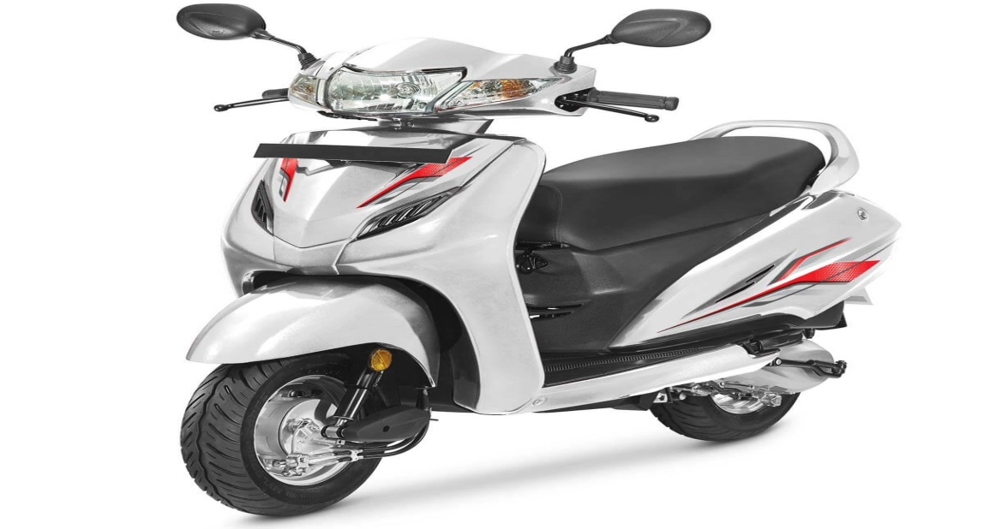
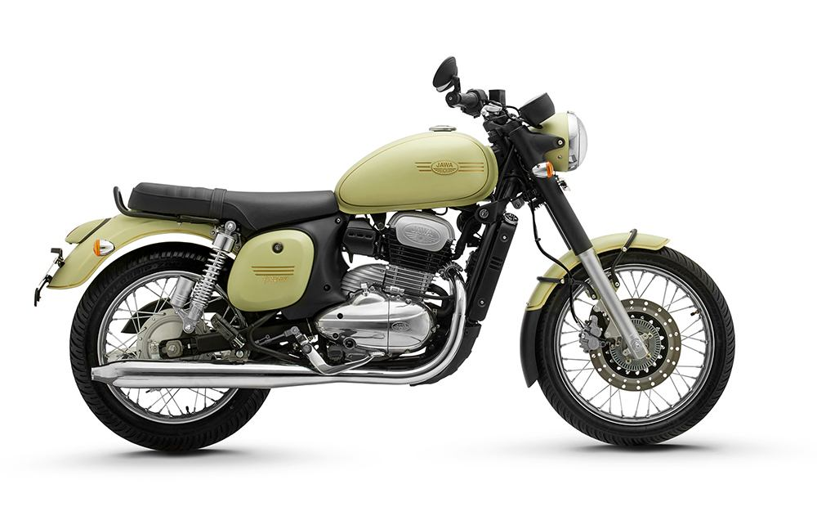
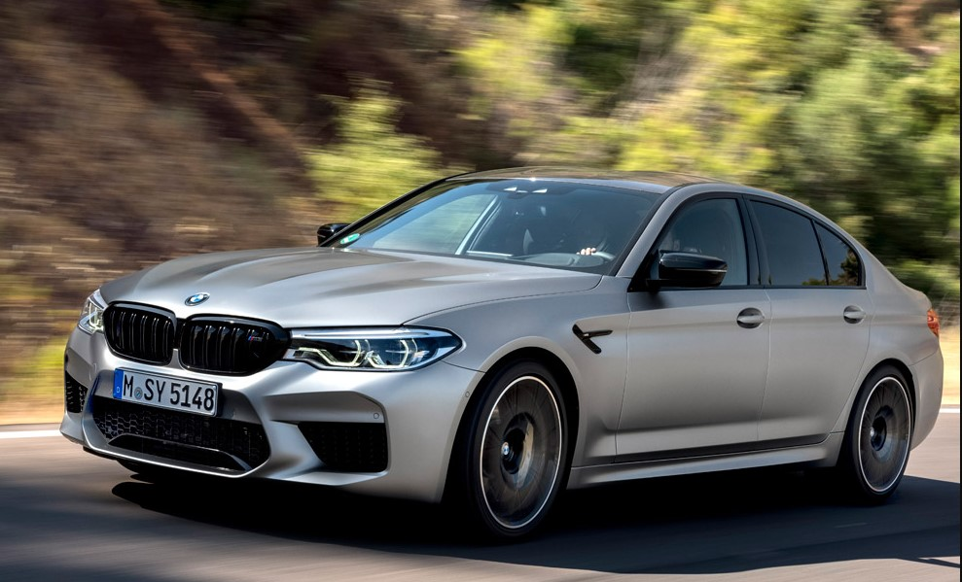
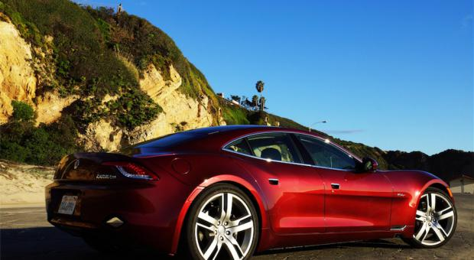
Health and Quality of life is the ultimate goal,
Be it ours or ours vehicle

Slide 3
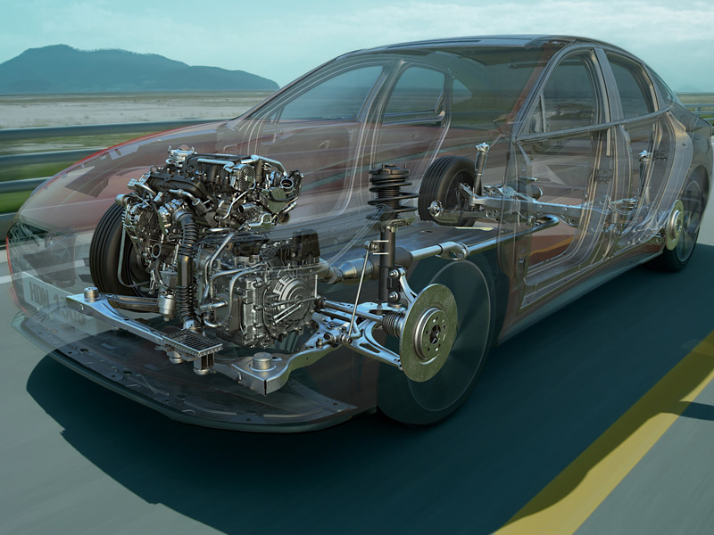
To keep the Vehicle at its best…
…Engine health is the key

Slide 4
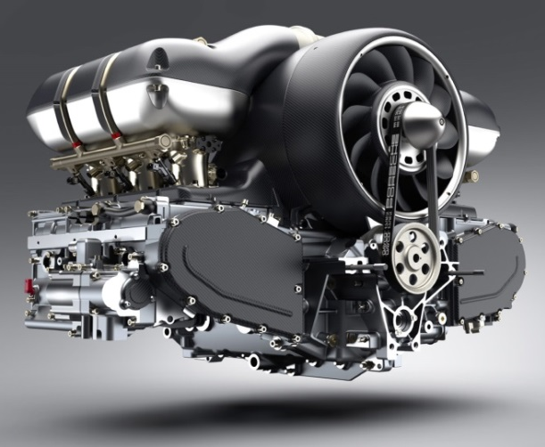
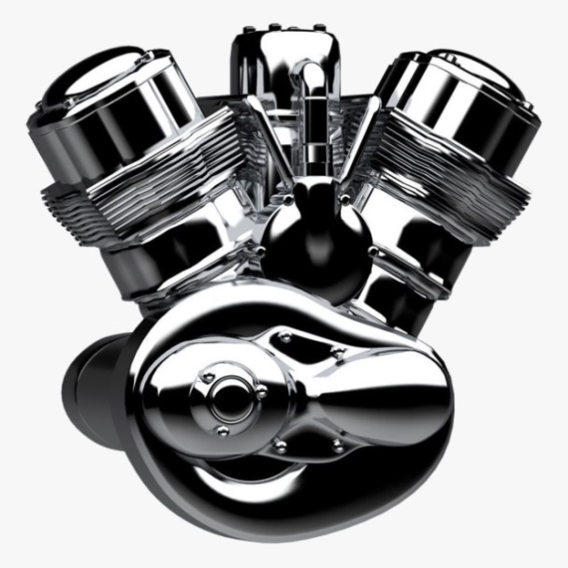
Why Engine Health is Important?
Engine Health: Keep vehicle working at its best
There are many benefits to ensure Vehicle’s engine is in good health & working order.
  For one, it will live longer, and will be less likely to suffer breakdowns as it ages.
  Enjoy lasting performance, with minimal dips in speed, responsiveness and fuel efficiency.
  And, regular engine maintenance will help the car’s value intact.

Slide 5




Vehicle Health, Engine Health & Our Health
Are
Interlinked

Slide 6
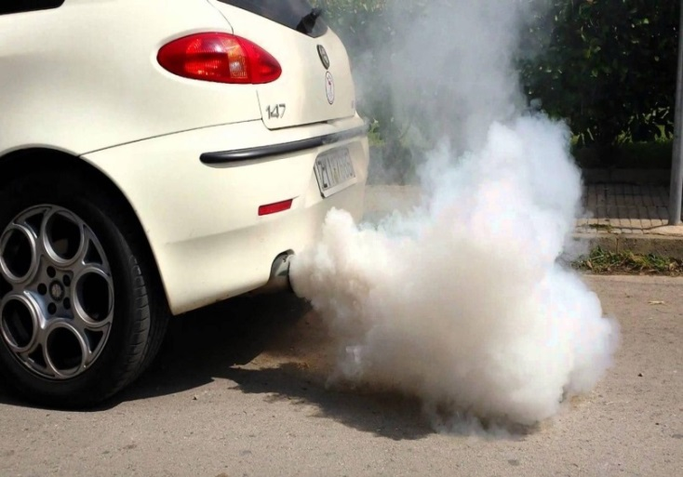
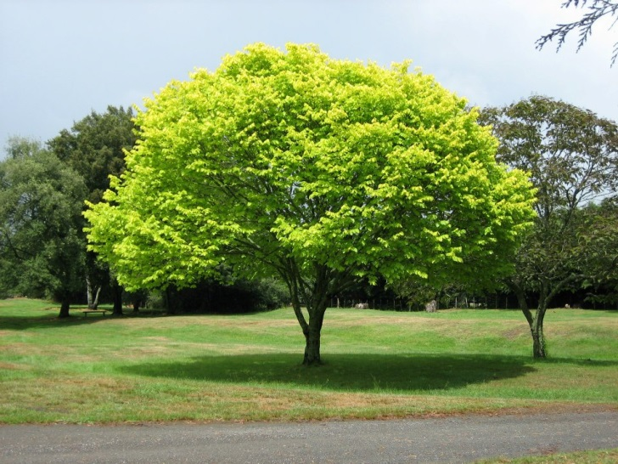
In India, 1 car emits 4600 kg of carbon dioxide every year*
To absorb this, ~220 fully grown trees are required^
*https://www.epa.gov/greenvehicles/greenhouse-gas-emissions-typical-passenger-vehicle
^http://urbanforestrynetwork.org/benefits/air%20quality.htm

Slide 7
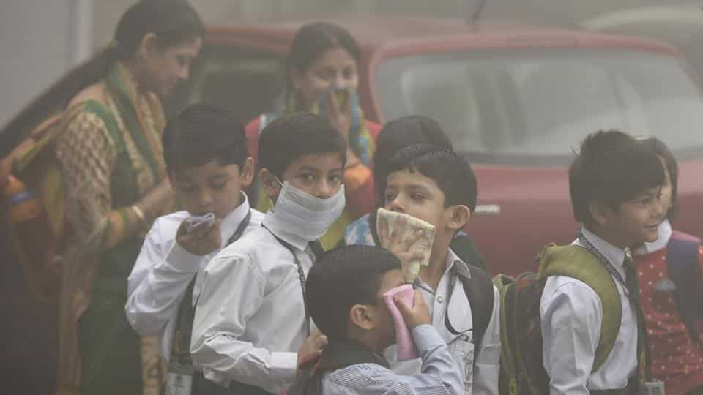
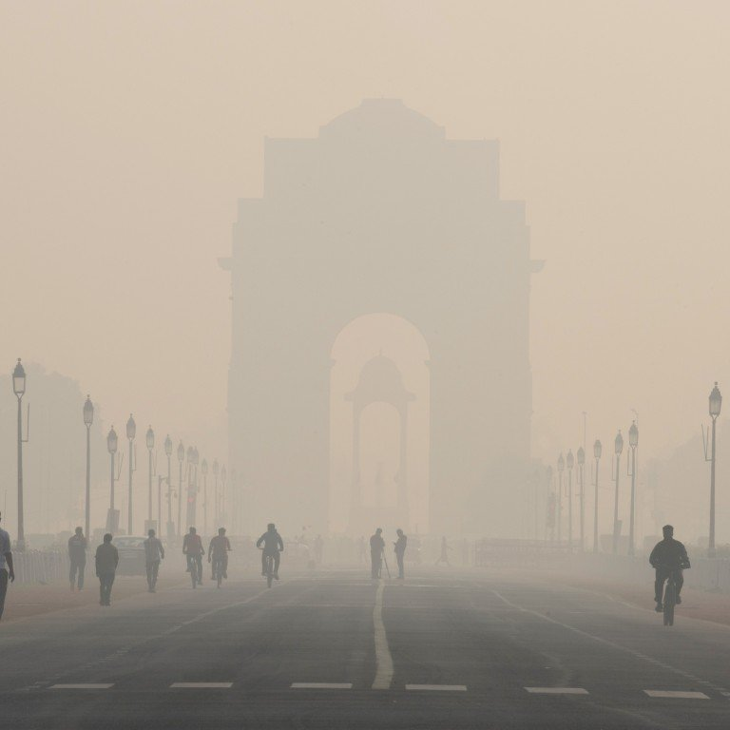
1 in 8 death every year is due to lung diseases caused by bad air quality
India has 6/10 most air polluted cities in the world
https://www.thehindu.com/news/national/air-pollution-cause-of-1-in-8-deaths/article25682272.ece
https://www.weforum.org/agenda/2020/03/6-of-the-world-s-10-most-polluted-cities-are-in-india/

Slide 8
We need to think,
What causes this pollution?
What is our role in this pollution?

Slide 9

It is our responsibility to take care of our environment

Slide 10

Presenting you a solution to make your vehicles engine more efficient and contribute towards environment

Slide 11
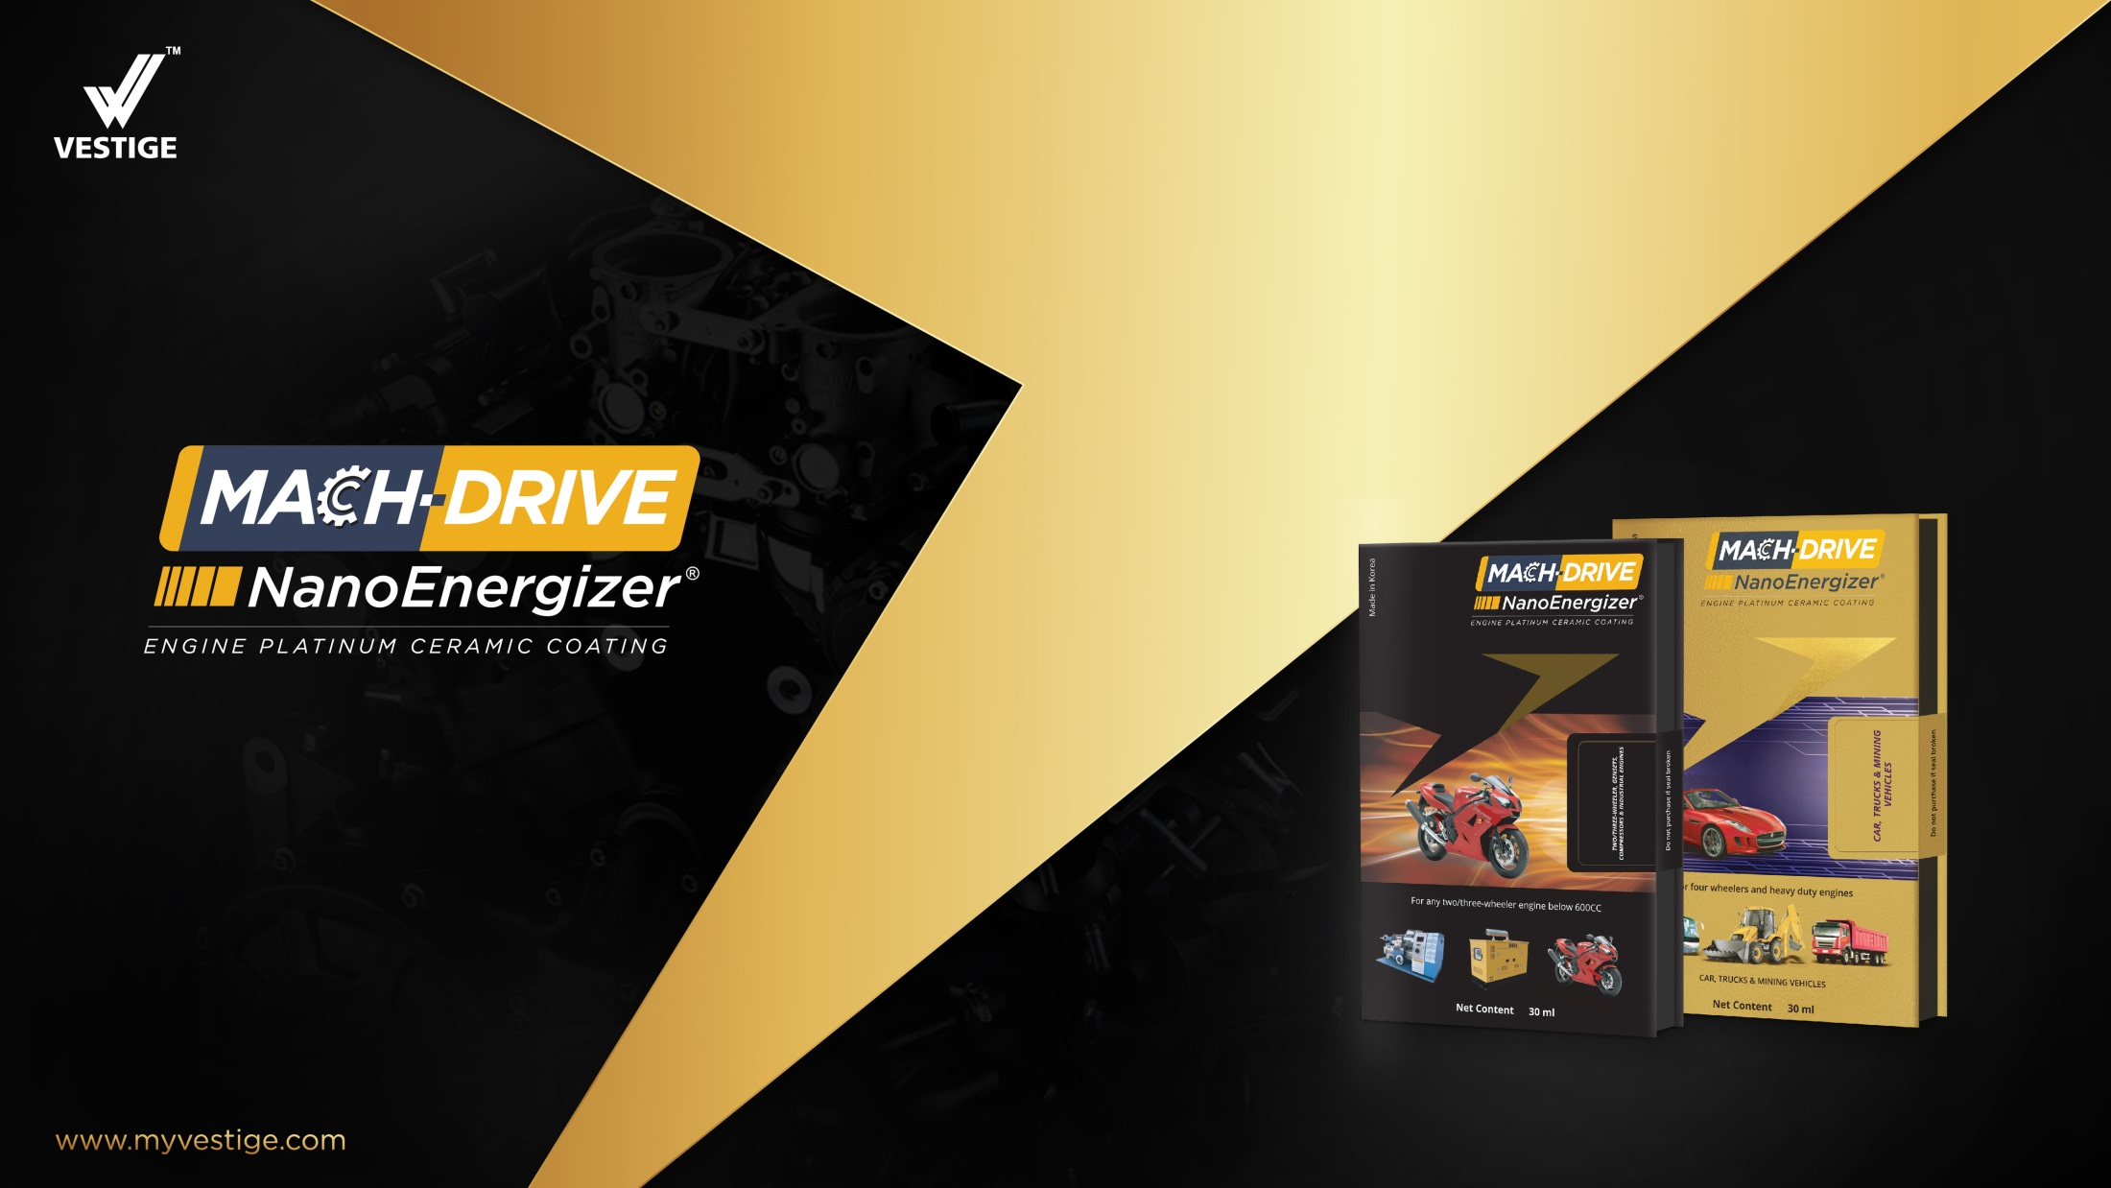
A Unique & Revolutionary Technology,
to enhance engine efficiency and also reduce pollution

Slide 12
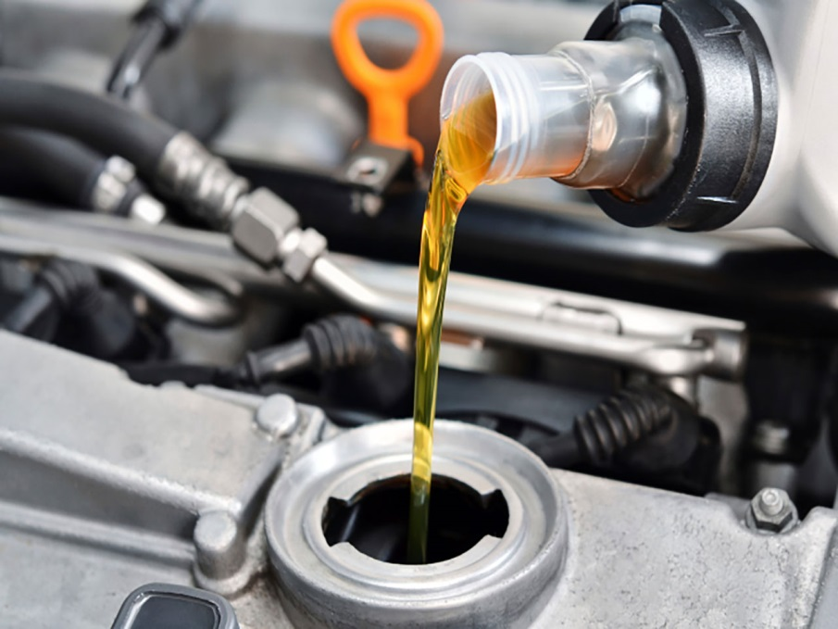
What is MACH-DRIVE NanoEnergizer
MACH-DRIVE Nano Energizer is an additive for engine along with Engine oil for better engine health
It gives platinum ceramic coating to engine, platinum is 20 times harder and 5 times shiner than steel
The result is a smoother, quieter engine with more power and better mileage

Slide 13
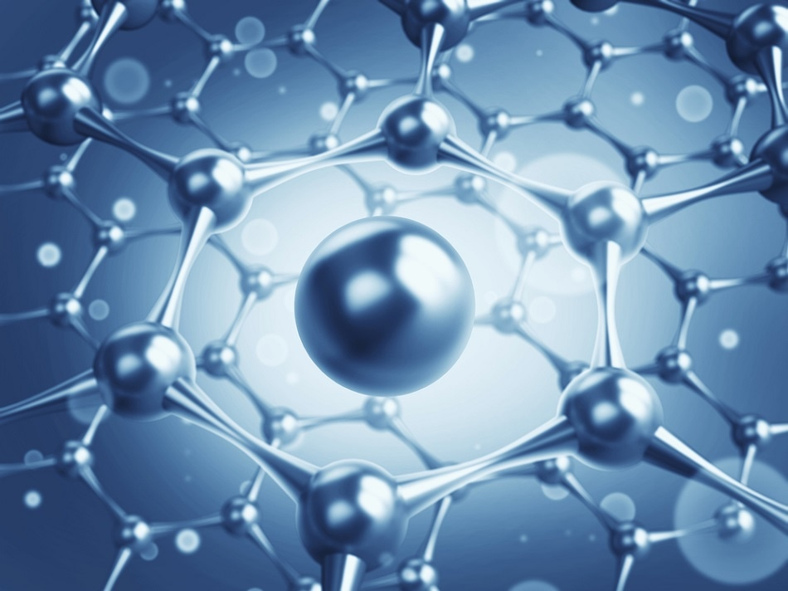
What is MACH-DRIVE NanoEnergizer
A Unique & Revolutionary Technology MACH-DRIVE is a perfect Nano Cermet - which is produced using a Ceramic plus Metallic Coating Technology.
It contains 20 Nano Meter Platinum Coated Zirconium Powder emulsified in mineral oil which is ideal for engine restoration & protection.

Slide 14
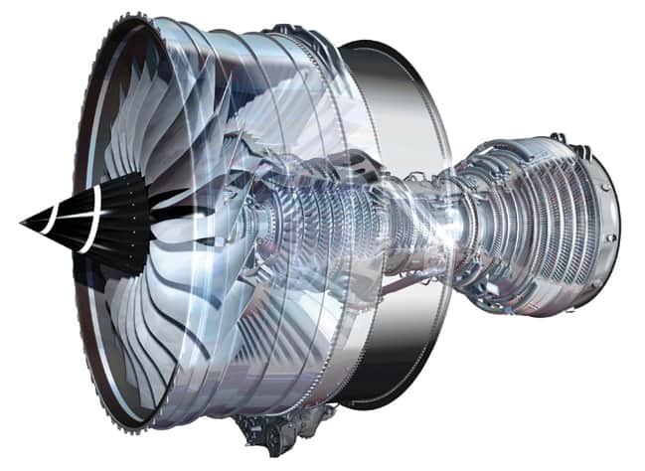
What is MACH-DRIVE NanoEnergizer
Platinum is 20 times harder and 6 times smoother than steel, these Nano particles create a hard & smooth coating layer on all the friction surfaces & moving parts inside the engine
Zirconium coating acts like a thermal barrier coating inside the engine cylinder and prevents heat loss.

Slide 15
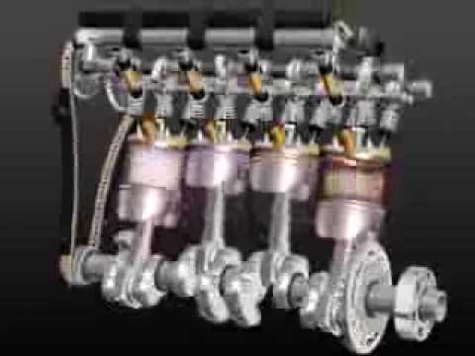
What is MACH-DRIVE NanoEnergizer
This is the only technology in the World which can convert any BS-IV Engine into BS-VI Engine without ever opening it for the next 30,000 Kms.
  It reduce Engine drag, friction and noise
  Bring engine power to 100%
  Increase compression
  Restore and protect engine
  Reduce fuel consumption
  Educe harmful exhaust emissions of all engines

Slide 16
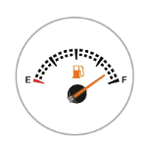





MACH-DRIVE NanoEnergizer Benefits
Improves mileage
upto 15% SAVING
REDUCES NOISE AND VIBRATION LEVELS
MORE PICKUP
RESTORES FRICTION SURFACES ANDENHANCES ENGINE LIFE
SINGLE COATING
LASTS UPTO
30 ,000 KMS
REDUCES overall EMISSION UPTO 70%

Slide 17
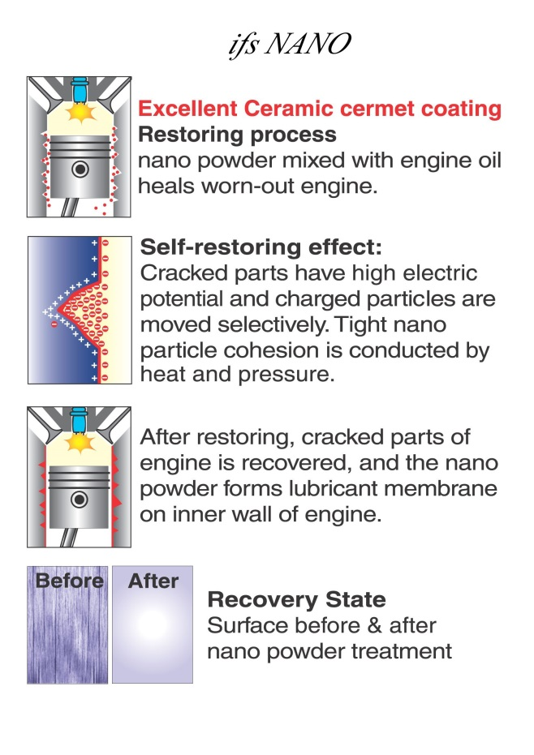
MACH-DRIVE NanoEnergizer: Improves Engine Efficiency
Brings engine power up to 100%
The Nano Energizer uses Revolutionary & Patented Nano Ceramic Technology It allows for easy Treatment of Engines and Restores, Repairs & Protects.
Ceramic coating, especially with Zirconium, has a beneficial effects on engine efficiency and performance

Slide 18
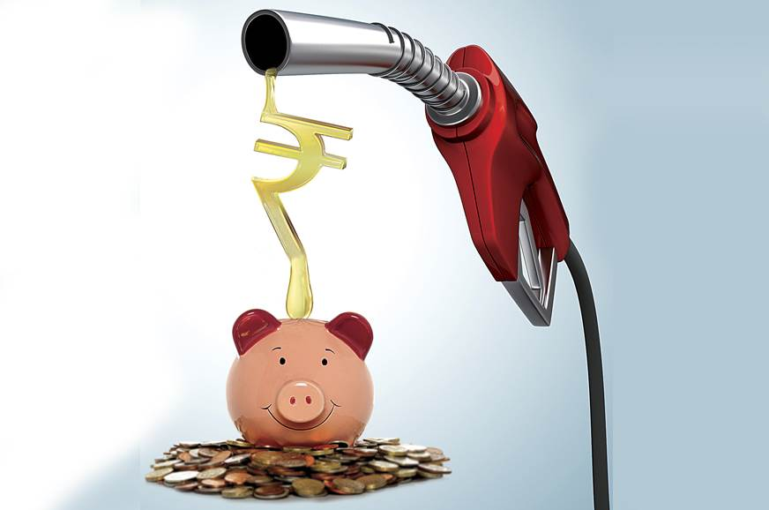
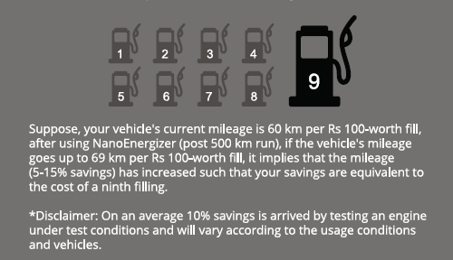
MACH-DRIVE NanoEnergizer: Improves Fuel Saving
Fuel saving upto 15%
Better mileage
9th fuel filling could be free

Slide 19

MACH-DRIVE NanoEnergizer: Reduces emission
Platinum coating helps to reduce emission upto 70%
It also reduces noise and vibration

Slide 20
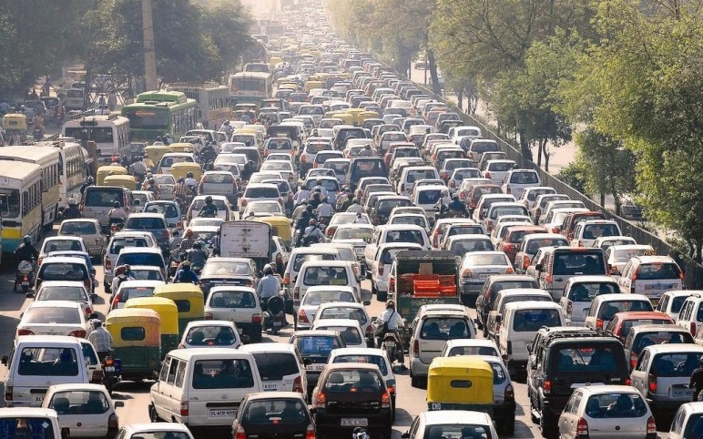
Eco-friendly MACH-DRIVE NanoEnergizer: Reduces CO₂
1 passenger vehicle emits 4600 kg of Carbon Dioxide (CO₂) in a year
By using MACHDRIVE, you are reducing 20% CO₂ emission per vehicle
Without MACHDRIVE
4600kg CO₂ every year
20%
With MACHDRIVE
3650kg CO₂ every year
*https://www.epa.gov/greenvehicles/greenhouse-gas-emissions-typical-passenger-vehicle
^http://urbanforestrynetwork.org/benefits/air%20quality.htm

Slide 21
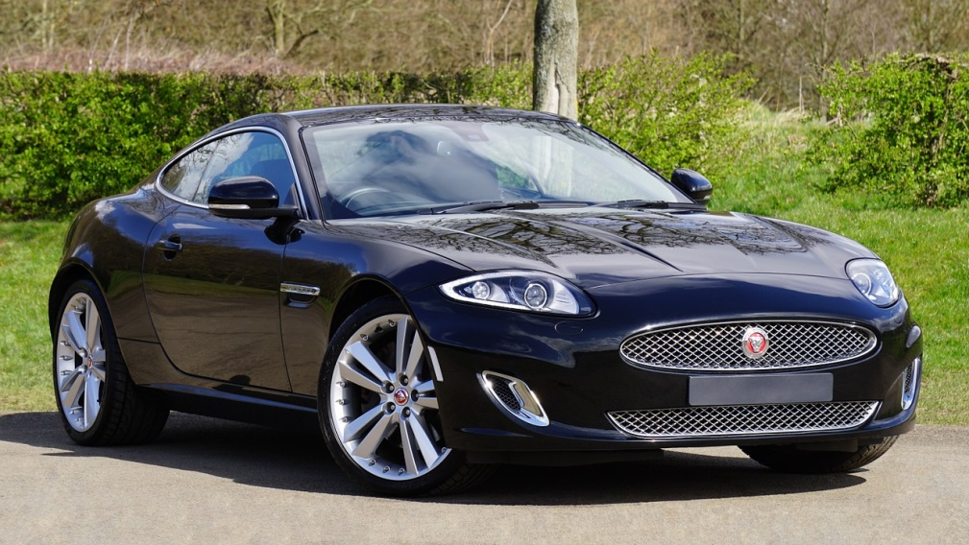
MACH-DRIVE NanoEnergizer: One time application
Single time coating last up to 30,000 km
After 30,000 km, apply again and make engine new again

Slide 22
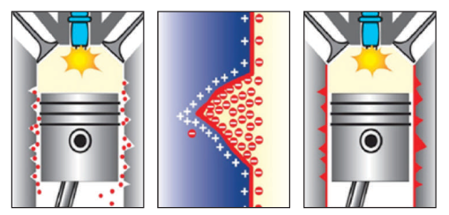
How does MACH-DRIVE NanoEnergizer works?
Ceramic coating nanotechnology. 20-nanometer, platinum-coated ceramic beads is to reduce wear, increase compression and longevity.
The new generation of ceramic coatings (zirconium oxide), Zirconium, or ZrO2, is a ceramic material that has been proven to be the most appropriate for engines. A single Injection ensures a powerful engine with smoother, quieter, more economical operation.

Slide 23
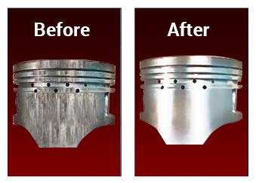
Change in Engine after MACH-DRIVE NanoEnergizer
MACH-DRIVE NanoEnergizer Makes Vehicle Engine Almost New

Slide 24
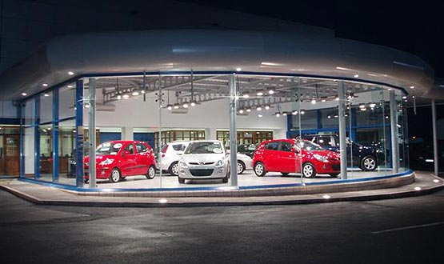
MACH-DRIVE NanoEnergizer
With MACH-DRIVE NanoEnergizer avoid frequent service station visits
Save time and money

Slide 25
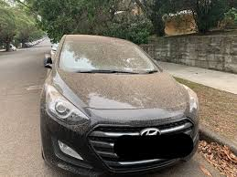
Why MACH-DRIVE NanoEnergizer even in lockdown?
Due to Lockdown, our vehicles are parked since long
This can make the engine oil settled at bottom
Sudden self start can lead to serious injury to engine, even it can seize
Platinum coating can prevent damage to engine and can repair it

Slide 26
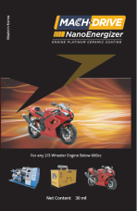
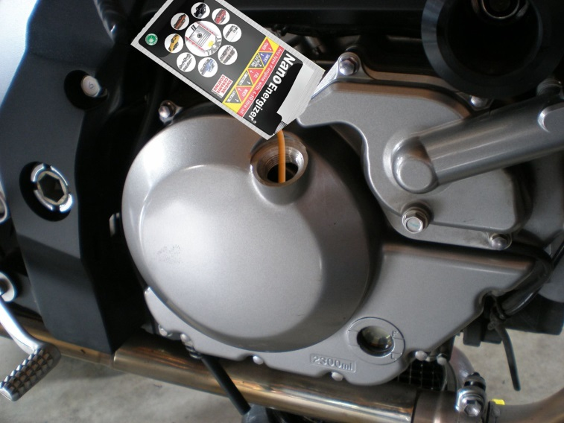
How to apply MACH-DRIVE NanoEnergizer?
It can be applied after the engine oil is changed, there is no need for re-dosing, recommended to change upon driving 30,000 km.
Injection Method:
Shake Nano Energizer enough (50 times) before injection. Open oil filler cap and inject Nano Energizer slowly.
Close oil filler cap and keep idle for 20 minutes or drive 30km.

Slide 27



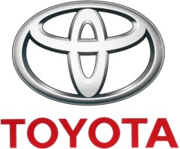
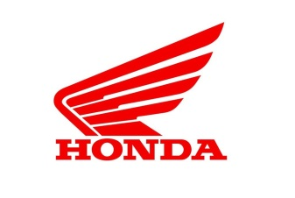
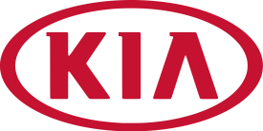
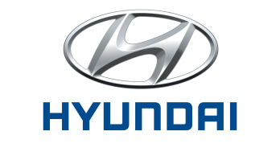

MACH-DRIVE NanoEnergizer Certifications
MACH-DRIVE NanoEnergizer is approved from various engine manufacturers

Slide 28

“Better Engine, Healthy World” with
MACH-DRIVE NanoEnergizer
An additive, it gives a platinum coating to the engine
Eco friendly (Reduces CO₂ emission)
Enhances engine life (makes it almost like new)
Increases horse power (efficiency ^15%)
Better mileage (fuel saving ~15%)
Reduced Air & Noise pollution

Slide 29

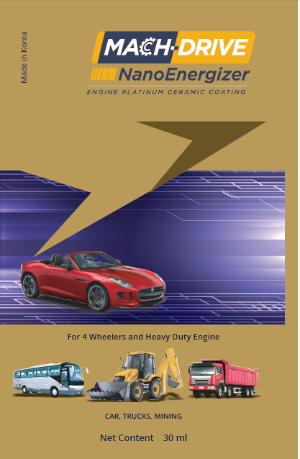
MACH-DRIVE NanoEnergizer
MRP : 1495
DP : 1280
PV : 42.67
MRP : 1870
DP : 1600
PV : 53.33

Slide 30
Don’t wait,
Buy MACH-DRIVE NanoEnergizer-
A revolutionary product today and gives better health to your vehicle’s engine and contribute towards environment

Slide 31

Check your knowledge
https://rb.gy/gjtmf7
or
Type
Scan

Slide 32


